Slide 1

AYSO Region 76
U-12 Coaching Course – 2012
Michael Karlin

Slide 2
Agenda
Classroom – 1:30 to 3:30 pm
  AYSO Fundamentals
  Team Management
  Teaching Methods and the Coaching Cycle
  Objective and Principles of the Game
  Systems of Play
  Laws of the Game
  Test
  Wrap up

Slide 3
Contact Information
Regional Commissioner – Mike Karon commissioner@ayso76.org
Coach Administrators – Ji Lee and Jeff Gross coach@ayso76.org
Webmaster – Michael Karlin webmaster@ayso76.org
Boys Under 12 Division Director – Patrick Reynolds – preynolds@ayso76.org
Girls Under 12 Division Director – Bernard Markowitz and Rand Bleimeister – gu12@ayso76.org
Our website:
  Public: www.ayso76.org
  Password protected: www.ayso76.net

Slide 4
AYSO Fundamentals
Vision Statement: To provide world class youth soccer programs that enrich children’s lives
Mission Statement: To develop and deliver quality youth soccer programs, which promote a fun, family environment based on our philosophies
AYSO Six Philosophies
  Everyone Plays – 2 and 3 quarter rule – we mean it!
  Open Registration – we take everyone
  Balanced Teams – no requests or player retention
  Positive Coaching – be nice
  Good Sportsmanship – teach the players to be nice
  Player Development – improve players skills

Slide 5
Local Philosophies
The primary goal of our coaching program is player development
  Defined as the improvement of all players’ individual and team skills to their maximum potential
  The program must meet the desire of players and their families for recreation that is safe, fun and educational
  IT’S NOT ABOUT WINNING! IT’S ABOUT TEACHING!
The program must also be rewarding for coaches.
  Coaches are volunteers, many with limited experience as educators and with the game of soccer
  To help them, we will provide and, in some cases, mandate the use of a wide variety of additional training and resources

Slide 6
Web Systems
eAYSO.org – National Program
  While eAYSO has many functionalities, the only one regional coaches need to use it for is for is volunteer registration
  Volunteer registration must be done once a year
  We no longer need to verify your identity every year – just the first time you register in our region
  E-signature is mandatory
ayso76.net – Regional Program
  Our entire program is administered using this system
Logins for these programs are separate and you have to register as a user for both

Slide 7
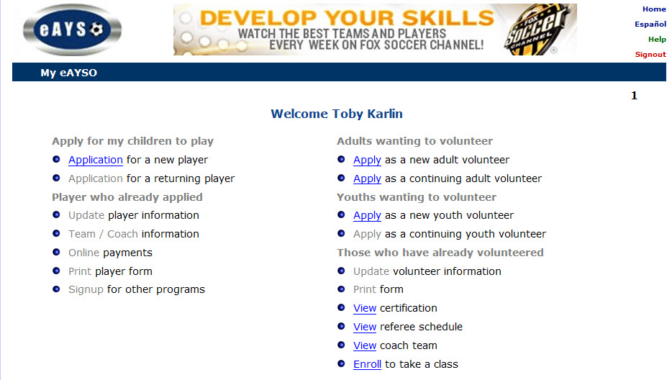
Registering in eAYSO

Slide 8
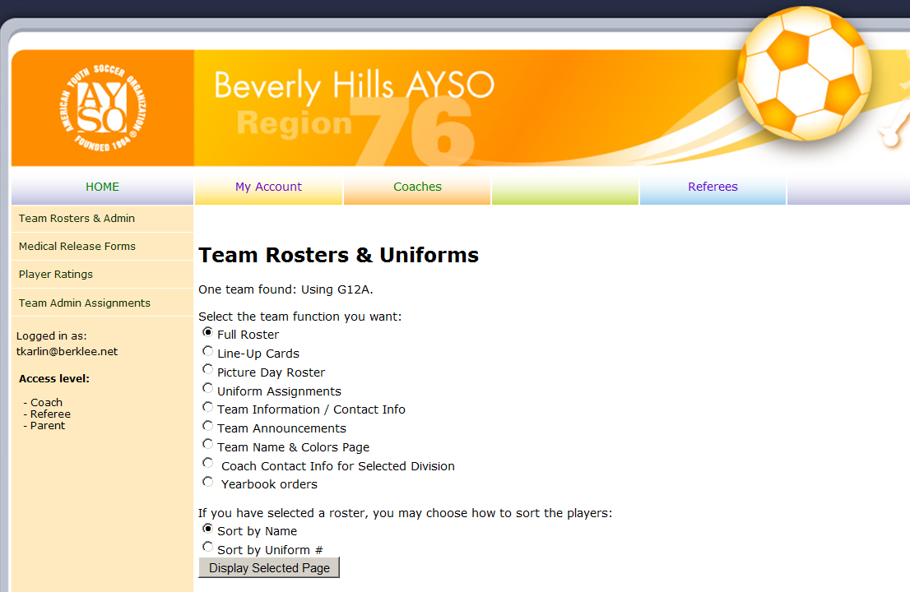

Slide 9
Before We Begin
“Failing to prepare is preparing to fail.”
John Wooden

Slide 10
Team Management
Organizing the Team
  Roster and other web resources
  Parent meeting and appointing a team administrator
    You can now do this
  Medical releases and Kid Zone Pledges
    A player cannot practice or play unless the coach is in possession of a signed medical release
Equipment
  Balls – size 4 for U10 and U12
  Cones – flat
  Practice vests – 7 x 2 colors
  First aid supplies (see below)
Practices and build-up
Game day preparation

Slide 11
Training Management
Prepare your practice before you get to the field
  Have a lesson plan – you are a teacher and the field is your classroom
  Be sure there is a ball for each player
    Players bring one each or you bring them
  Training uniforms (white t-shirt, black shorts) promotes team spirit
You have just one hour
  Arrive early and appropriately dressed
  Require players to arrive 15 minutes before official start time, so they can put on cleats and get ready
  Work with assistants to mark out spaces with flat cones
  Warm up on the sideline if you can
Hydration is vital:
  Short, disciplined breaks, especially early in season
  Water not sweetened drinks so players take more fluid

Slide 12
Training Management
Practices should be planned into 5 segments:
  Warm-up (at least 80% free play with the ball) – 5-10 minutes; use dynamic not static stretches
  One or two skill drills – 20 minutes
  A scrimmage or game – 15-20 minutes
  A second drill at the end – 5-7 minutes
  Cool down run and stretch after practice, not before
You don’t have to make it up. Several curricula for U12 are available (see last slide)
All activities should involve frequent touches – NO STANDING IN LONG LINES – for a shooting drill without lines, see the Appendix
If it doesn’t work, stop. Do something else.
Use the Coaching Cycle and concept of Build-up
Notes:
Static stretching involves stretching movements performed at gradually
increased speed. False

Slide 13
Game Day Management
Punctuality and Warm-Up
Line-up
  Line-up cards (use the web application; uniform order)
  Plan your substitutions – three-quarter rule until playoffs
  Rotate players into different positions
First aid supplies
  Ice and ice packs
  Bandages and disinfectant
  Advil, Alleve: Don’t give it to players – leave this to parents

Slide 14
Game Day Management
Bring a chair
KEEP QUIET DURING THE PLAY
  Players learn best from their own mistakes
  “If you're not making mistakes, then you're not doing anything.” – John Wooden
  Error prevention hurts your players
COACH, DON’T CRITICIZE
Coach before the game and at the breaks
Coach the substitutes
After the game, cool down and review
Let the game be the teacher

Slide 15
Teaching Methods
P.I.E. (Positive Instruction & Encouragement)
    Coaching Sandwich: A slice of critique inside two slices of praise
Say, Show, Do and Review (explain, demonstrate, have them do it, correct)
See, Show, Say Method (watch, show them what needs to be corrected or improved, and then critique)

Slide 16
Coaching Cycle
Systematically build up training session with
Warm Up
Free Play
Drills
Small Games
Elements of training
Techniques
Tactics
Conditioning
Motivation
Speed
Improved player and team performance
Practice
Build up individual elements of training by varying
Speed
Space
Opposition
Evaluate and observe performance of match characteristics. Select elements for next practice

Slide 17
Build-Up
Learn the concept of build-up
  Start with no pressure – time or space
  Limited pressure – reduce time or space; add opponent(s)
  Full pressure – players involved in game-like situations
  Game conditions – game with rules designed to emphasize what you want to teach – small-sided games are the best way to do this
Give time to weaker players – how well you coach them will determine your team’s success

Slide 18
Scrimmages and Games
Don’t just scrimmage. Scrimmages should be tuned to the practice theme. For example:
  To teach offence:
    Use unbalanced teams
    Shorten the field to eliminate transition
  To teach passing:
    Use Hands Game
    Alley Game - create a field with cone-demarcated passing lanes
Coaches:
  Play only if you know what you’re doing
  Don’t show off and don’t score
  BE CAREFUL –players are 1/3rd to ½ of your weight
Scrimmage in mid-session, not the end, so players don’t spend all practice waiting for it to begin

Slide 19
Technique and Tactics
Soccer is an individual sport and a team game
Before the age of 12, the primary emphasis has to be on individual technique:
  Bringing the ball under control
  Moving with the ball
  Kicking the ball accurately and at the right pace
  One on one play
Team tactics become more important as players get older – but understand that the key to tactical success, spatial awareness, develops over time and is not fully developed at 11 years old
U12 is primarily about “Technical Cleansing”
Notes:
Primarily cover techniques in the field sessions.

Slide 20
Training Overview for U-12 Players
U-12 Techniques | U-12 Knowledge
Dribbling | Know the 8 restarts
Inside of foot – ball control | Corner kick
Sole of foot – ball control | Goal kick
Top of the thigh – ball control | Penalty kick
Instep kick | Drop ball
Inside of the foot – push pass | Direct free kick
Heading (not before U12) | Indirect free kick
Throw-in | Throw-in
Tackling | Kick off
Goalkeeping | Laws of the Game
We cover techniques during the field sessions

Slide 21
Objectives of the Game
Attacking Objectives | Defending Objectives
Score | Prevent Scoring
Move the Ball Forward | Delay the Opponents
Keep the Ball | Get the Ball Back
Players are taught the objectives and principles through training sessions, not during the game
Notes:
Maintain possession v regain possession

Slide 22
Principles of Play
How to achieve your objectives
Attacking | Defending
Penetration – Advance ball by dribbling, passing and shooting | Delay – Slow down the attack
Depth – Give your teammates options | Depth – Support the player challenging for the ball
Mobility – Don’t just stand there! | Balance – Match other team’s numbers
Width – Spread out; use the space | Concentration – Play in a small space
(added at U12) Creativity – Use your skills | (added at U12) Composure – Stay calm; don’t dive!

Slide 23
Systems of Play
Systems of Play
  4-4-2, 4-3-3, 3-4-3, 4-5-1, 2-3-5 OR
  Everyone defends, everyone attacks and everyone helps teammates nearby
  Mobility and numbers matter more than systems
  Whatever else you do, don’t have defenders standing back while the forwards attack
    In a practice, do you ask 2-3 forwards to score against 8 players?
    Risk breakaways – they rarely score

Slide 24
Positional Skills
Except for the keeper, in the modern game, the technical skills are the same at every position
  Touch and ball control
  Dribbling – dribble like you run
  Solid kicking skills
  Awareness
    Think where the ball may go next
    Think what you could do to help your teammate
  Positioning off the ball
    On attack: Get open, meaning away from defenders
    On defense:
      Get ball side and goal side
      Support your teammate
      Be patient when challenging an attacker - go for the ball only if sure you can get it
Emphasize areas of responsibility, not positions

Slide 25
Positional Responsibilities
Position
Own Team Has Ball
Other Team Has Ball
Goalkeeper
Defender
Midfielder
Forward
Begin Attack
Keep Ball
Advance Ball
Advance ball
Keep Ball
Score
Advance ball
Keep ball
Stop scoring try
Stop scoring try
Regain ball
Delay attack
Regain ball
Regain ball
Delay attack

Slide 26
Laws of the Game
What players (and coaches) need to know
  Ball in and out of play – if part of ball is on the line, it is in play; a ball that hasn’t fully crossed the line is not out
  Throw-in technique – arms straight, ball over head
  Direct v. indirect kick – 2nd touch before goal can be scored
  Goalkeeper infractions
    Don’t pick ball up on
      Deliberate pass back by foot
      Throw-in
    More than 6 seconds before releasing ball from hands
    Handling ball up outside penalty area (but can dribble ball into penalty area and then pick up)
  Basics of offside
    Offside position v offside
    Stay level with last defender (not including keeper)

Slide 27
Field Sessions
Required elements
  Techniques
    Dribbling
    Inside of the Foot – Ball Control
    Sole of the Foot – Ball Control
    Top of the Thigh – Ball Control
    Instep Kick
    Inside of the Foot – Push Pass
    Heading
    Throw-In
    Tackling – Front Block
    Goalkeeping – try to put everyone in goal for at least a quarter
  Build up the techniques
  Training games

Slide 28
Resources
Before you do anything else, watch pros in action: http://www.youtube.com/watch?v=Xm33Z_2sZj8
Look at the curriculum on UK International’s website coaches’ website:
  www.uksocca.com or go directly to http://76.89.105.17/Curriculum/home.php
  User name AYSO76 and password BeverlyHills (no spaces)
Check out www.ayso.org/resources/coach_res.aspx
Watch some skills training videos (Coerver’s are expensive but the best) – more information can be found at http://www.playgreatsoccer.com
Massachusetts Youth Soccer statewide curriculum is great for learning what to expect from players at different ages and maturity levels http://www.mayouthsoccer.org/download/273_statewide_curriculum_u6_u12_2_.pdf.
We like www.soccerclinics.com and www.grassrootscoaching.com/ because of the animated diagrams – but there are subscription fees
www.dprsports.com/drills.htm and www.soccerxpert.com have lots of free drills
Schedule free practice session with UK International coaches or have a member of the Coaching Commission mentor you at a game: Contact the coach administrator (coach@ayso76.org)
Laws of the Game http://www.fifa.com/aboutfifa/documentlibrary/doclists/laws.html#laws
U.S. Soccer Federation resources - http://www.ussoccer.com/Referees/Laws-of-the-Game.aspx

Slide 29






Handball Game
goal catcher
goal catcher
Keep field quite small (30 x 25 yards)
Object is to find open space near (but not too close to) teammates
To score, all players must catch ball, then throw to their “goal catcher”
Stop play to stress need to spread out and OK to pass back
No offside (so red forward is available for quick pass)
Variation/progression: Maximum of 3 steps before passing
Progression: Alternate throw in air, then roll on ground

Slide 30


Alley Game
●
●
●
●
●
●
●
Safe zone
Safe zone
●
●
●
●
●
●
●
●
●
●
●
●
●
●
Safe zone
Safe zone
4-6 yards
●
●
●
●
●
●
●
Variations:
  Basic: 1 red in one lane, 1 blue in the other
  1 red and 1 blue in each lane
  Anyone can go into lane with ball; while there, player is “safe”
Coaching points
  Player in safe zone should pass back, not at goalkeeper
  Midfield player should trail safe zone player (option for pass back)

Slide 31
Teaching Shooting Without Lines
5 players – GK plus 2 on one side of goal, 2 on the other
Basic set-up: Player shoots; if GK saves, turns and feeds to player on opposite side of goal; if ball passes GK, player on opposite side has ball and can shoot
Progressions
  Player with ball takes ball toward goal, turns and lays it off for teammate
  Player passes the ball sharply to GK who parries it for other player to follow up
  Player with ball runs wide of goal and passes angled ball back to teammate

