Slide 1

American Youth Soccer Organization (AYSO) Region 76
presents:
The AYSO U-6 Coaching Course
Presenter: Michael Karlin

Slide 2
Contact Information
Regional Commissioner – Jeff Pop commissioner@ayso76.org
Coach Administrators – Ji Lee and Jeff Gross coach@ayso76.org
Webmaster – Michael Karlin webmaster@ayso76.org
Boys Under 6 Division Director – Linda Drucker– ldrucker@ayso76.org
Girls Under 12 Division Director – Susan Edelman – sedeleman@ayso76.org
Our website:
  Public: www.ayso76.org
  Password protected: www.ayso76.net

Slide 3
Web Systems
eAYSO.org – National Program
  The only eAYSO functionality you need is volunteer registration
  Volunteer registration must be done once a year
  We must verify your identity the first time you register in our region
ayso76.net – Regional Program
  Our program is administered using this system
Logins for these programs are separate and you have to register as a user for both

Slide 4
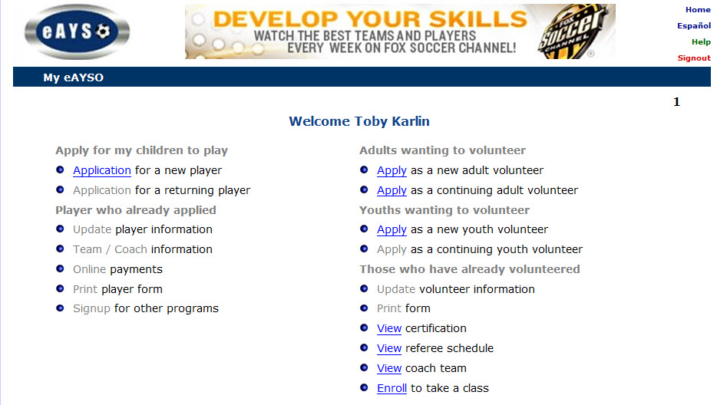
Registering in eAYSO

Slide 5
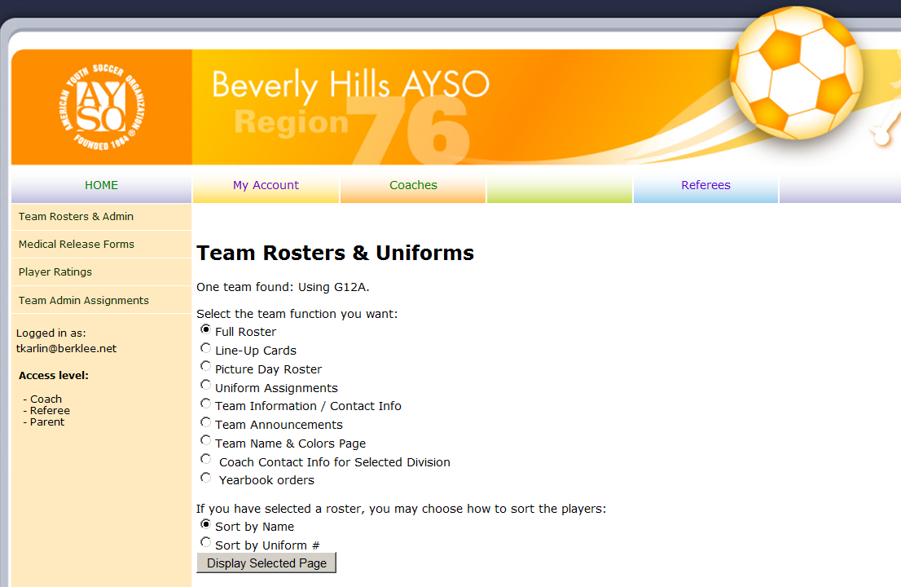

Slide 6
Before We Begin
“Failing to prepare is preparing to fail.”
John Wooden

Slide 7
U-6 Coaching Course
Overview:
AYSO Vision & Mission Statement
AYSO 6 Philosophies
The Psychology of Coaching
Team Management
Training Overview for U-6 Players
Objectives & Principles of the game
Teaching Methods
Techniques – On the field
Training Games – On the field

Slide 8
U-6 Coach Course
Vision Statement
To provide world class youth soccer programs that enrich children’s lives
Mission Statement
To develop and deliver quality youth soccer programs, which promote a fun, family environment based on the AYSO Philosophies…

Slide 9
AYSO Philosophies:
Open Registration
Everyone Plays
Balanced Teams
Positive Coaching
Good Sportsmanship
Player Development…

Slide 10
AYSO Philosophies:
Everyone Plays
Our program’s goal is for kids to play soccer—so we mandate that every player on every team must play at least half of every game.
Balanced Teams
Each year we form new teams as evenly balanced as possible—because it is fair and more fun when teams of equal ability play. ..

Slide 11
AYSO Philosophies:
Open Registration
Our program is open to all children between 4 and 19 years of age who want to register and play soccer. Interest and enthusiasm are the only criteria for playing.
Positive Coaching
Encouragement of player effort provides for greater enjoyment by the players and ultimately leads to better-skilled and better-motivated players…

Slide 12
AYSO Philosophies:
Good Sportsmanship
We strive to create a positive environment based on mutual respect rather than a win at all costs attitude, and our program is designed to instill good sportsmanship in every facet of AYSO…

Slide 13
AYSO Philosophies:
Player Development
  We believe that all players should be
  able to develop their soccer skills and
  knowledge to the best of their abilities,
  both individually and as members of a
  team, in order to maximize their
  enjoyment of the game…

Slide 14
The U-6 Program is a program of?
Discovery for players…

Slide 15
The Psychology of Coaching

Slide 16
Working with Young Athletes
As coaches we need to recognize that each athlete is an individual with unique needs and that we treat them accordingly.
Understand that players want to enjoy attending practices and games…

Slide 17
Working with Young Athletes
Organize your activities and games so that every player has an opportunity to develop and maintain positive feelings of self-worth.
Provide positive encouragement to all players for both success and mistakes…

Slide 18
Working with Young Athletes
Play in this very young age group is meant
to give a “taste” of the game, some
experience in working together as a team,
and, most of all, a positive introduction to
sports …

Slide 19
What to Expect from U-6 Players
Remember that kids will develop
differently, both physically and
socially.
You must take the needs of ALL of
your players into consideration…

Slide 20
U-6 Physical/Gross Motor Development
Are in the early stages of development.
Can run, jump, and skip well; motor skills
are continuing to develop.
Have lots of energy, although in bursts; they tend to tire quickly.
Can perform runs, starts and stops.
Can’t sit still for long…

Slide 21
U-6 Social/Emotional Development
May have fears of the unknown
Experience rapid and unpredictable mood
changes
Tell tall tales
Need encouragement
May have difficulty sharing
Crave praise and attention…

Slide 22
U-6 Cognitive/Thought Development
Do not like to repeat.
Lack judgment regarding their own safety
and abilities.
Don’t think logically.
Ask lots of questions.
Are fond of stories…

Slide 23
Things To Remember About
The U-6 Player (summary)
They don’t think like adults!
Are extremely curious and impatient
They just won’t stand or sit still
They have a short attention span…

Slide 24
Things To Remember About
The U-6 Player
Verbal and communication skills are limited
They will take what you show or tell literally, so be sure to say exactly what you mean
You look very big and frightening
Talk to them at their level – so kneel down!
Lastly, make everything positive and they will respond positively to you and your directions…

Slide 25
Things To Remember About
The U-6 Player
Must be treated as children, not as mini-adults.
Are self-oriented and naturally relate only to a friend or two, not to groups of six or more.
Cannot sustain prolonged activity, and can
function best with frequent rest periods.
Focus best when learning activities are fun…

Slide 26
Team Management
Organizing the Team: This should be your
first priority!
Basics
Develop a Team Goal
Develop a Coaching Philosophy
Conduct a Parents’ Meeting

Slide 27
Team Management
Basics
  Roster and other web resources
  Parent meeting and appointing a team administrator
    You can now do this
  Medical releases and Kid Zone Pledges
    A player cannot practice or play unless the coach is in possession of a signed medical release
    You can download these at ayso76.net – so can the parents

Slide 28
Develop a Team Goal
Try:
  “Players having FUN while learning about
  soccer” is a good base for a team goal.
  You, the parents and players can build on
  that foundation…

Slide 29
Develop a Coaching Philosophy
Why are you Coaching?
Why should you be Coaching?...

Slide 30
Conducting a Parents’ Meeting
Discuss AYSO’s Vision and Mission Statements and the 6 Philosophies.
Discuss the team’s goals.
Explain your coaching philosophy.
Explain short-sided soccer and why we play it.
Educate parents briefly on the Laws of the Game specific to this age group.
Discuss player equipment needs…

Slide 31
Conducting a Parents’ Meeting
Set team policies.
GET HELP – You will need (at a minimum):
  Assistant Coaches
  Team Manager
  Team Parent…

Slide 32
Coach Equipment
The following is a basic list of equipment you should have with you on activity day:
Player medical release forms
A basic first-aid kit
A water container and cups
Soccer balls (size 3)
An extra pair of shin guards (maybe several!)
A marking pen for labeling
A whistle
Your players should bring a ball to every
activity and must wear shin guards…

Slide 33
Training Management
Prepare before you get to the field
  Have a lesson plan – you are a teacher and the field is your classroom
  Be sure there is a ball for each player
You have just one hour
  Arrive early and appropriately dressed
  Require players to arrive 15 minutes before official start time
  Mark out spaces with flat cones
Hydration is vital:
  Frequent short breaks, especially early in season

Slide 34
Training Management
All activities should involve frequent touches – NO STANDING IN LONG LINES
If it doesn’t work, stop. Do something else

Slide 35
Activity Day (Game day)
After the Game
  Shake hands with the other team!
  Congratulate players
  Reminder on next activity date…

Slide 36
Objectives of the Game
If your team has the ball, your team is attacking.
Attacking Objective
Score…

Slide 37
Defending Objectives
If the other team has the ball, you are defending.
Defending Objectives
Stop the other team from scoring

Slide 38
Principles of Play
The Principles of Play are used to
achieve the Objectives of the game…

Slide 39
Attacking Principle
Penetration:
Move the ball past the other team’s players by dribbling, passing and shooting.

Slide 40
Defending Principle
Delay: To slow down the other team by
closing gaps and denying space for
the other team to work in. Once the other team is slowed, your team can
try to take the ball back.
Good LUCK!...

Slide 41
Principles of Play
Attacking Principles | Defending Principles
Penetrate | Delay

Slide 42
Teaching Methods
Positive Instruction Encouragement (P.I.E.)
All players will respond better to you
and it will help keep AYSO the
positive place it should be for all...

Slide 43
Teaching Methods
Say, Show, Do and Review
Say: Explain the skill or technique.
Show: Demonstrate the skill or technique.
Do: Have players perform the skill or technique.
Review: Review, correct and confirm proper technique.

Slide 44
You are now ready for the field segment of the U-6 Coach training.
One more thing…

Slide 45
What is the BEST Teacher of the Game?
The game itself!
Kids just want to PLAY!...

